Slide 1

Lucas Gallagher
Attack Surface-as-a-Service
SECURITY IN SERVERLESS TECHNOLOGIES
Security Architect – Foot Locker, inc
Notes:
Good afternoon! I'm Lucas Gallagher, Security Architect with Foot Locker,
and today I'll be talking about securing serverless technologies.
I confess, it's a bit strange to be presenting in person—to real people!
It’s a welcome change, but they didn't tell me where the button to disable video in case I have to sneeze, or eat a few chips.
LEAD-IN As the technology that we are highlighting here, let's talk in brief about [X]

Slide 2
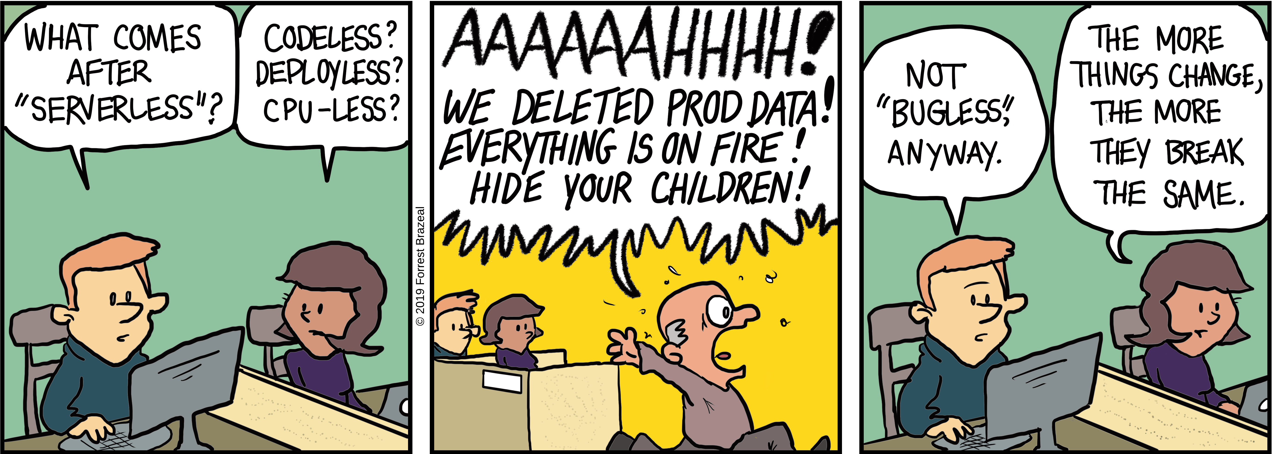
Serverless?
Forrest Brazeal - https://faasandfurious.com/108
Notes:
'Serverless’ -serverless compute in a nutshell is a platform that allows code or operations to be performed without knowledge of underlying infrastructure
w/o having to worry about or maintain hardware, operating system, dependencies, or even software in many cases.
Popularized by AWS's Lambda, allows code->upload->Lambda func->run w/defined trigger. 'Functions as a Service' or FaaS, and all the clouds are doing it these days. Google Cloud - Cloud Functions, Azure - Azure Functions, etc. Extends into many other domains as well: DBaaS, low/no code platforms (Azure's Logic Apps), and others
Powerful stuff! In some ways this is fulfilling the promise of cloud computing--not just 'my VM in someone else's datacenter', but 'my application runs on the cloud’.
The comic pokes fun at it, (issues), but with serverless technologies it becomes much easier to create
automation,
spin up database
a full stack application
with shorter time to market that has greater capability and integration.
[X] Here are specific examples in Azure.

Slide 3




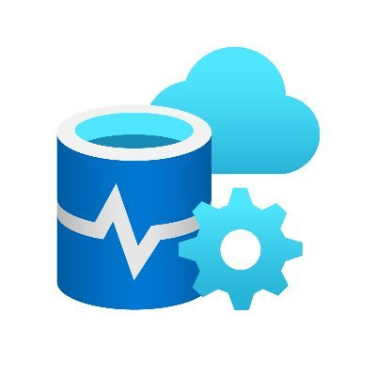
full stack app
Web Frontend
API
Database
Azure Web App
Function App
Cosmos DB

Slide 4
full stack app
Function-as-a-Service
Full Stack Web App
Storage-as-a-Service
Azure Web App
(Web)
Function App
(API)
Function App
Azure Blob Storage
Azure SQL DB
(DB)
Notes:
[X] Azure Functions is a serverless compute platform. It can run a single script on demand, or a fully defined API for an application.
[X] Building on that, the second example is a simple full stack application deployed in an Azure subscription. The web frontend? Serverless. The API? Serverless. The Database? Serverless Database as a service.
No element of this requires managing a server or a host. Easy versus traditional And it is relatively easy to assemble and deploy--especially when compared with the learning curve of deploying a full stack app with other methods.
[X] Lastly we have Azure Blob Storage--think Amazon S3 buckets. Could drag and drop files using a desktop app, or it could be the storage backend of a complex system.
All of these can be interacted with in various ways: web ui, desktop client or IDE extension, via API, or directly via a URL.
As you can tell, I’m a fan. Alright, done geeking out about serverless. Hopefully I was able to convey the benefits and possibilities, and why these technologies are in many cases transforming business applications and processes.

Slide 5

Attack Surface
Azure Web App
*.azurewebsites.net
(or custom domain)
Function App
*.azurewebsites.net
Azure SQL DB
*.database.windows.net
Notes:
Sticking with web app -> attack surface. Attack surface is your exposure to threats. Can involve unauthorized access, denial of service—all the things that can compromise the CIA of your app, data or environment.
Physical locations -> armful of donuts corp site. Virtual locations -> server with a port accessible from internet
couple ways Serverless ^ atk srfc over traditional—including one way that differentiates vs server compute resources in a cloud such as Azure.
Unlike traditional applications, where just the webhost frontend is internet-accessible, a deployment of most serverless entities are all internet-accessible by default--[X] and it's not a bug, it's a feature!
One of the great benefits of Serverless offerings is how flexible and interoperable they are. A function can operate standalone, or as part of a larger full stack application. But that same flexibility means that it is really easy to accidentally--or in ignorance--deploy it in an insecure manner—
[X] and with a large attack surface.
Let’s dig a bit deeper into the opportunities the attacker has—and conversely the security concerns around serverless

Slide 6

Attacker Opportunities - Security Concerns
Azure Web App
Exposure
Function App
Azure SQL DB
Notes:
Exposure
Can anyone or anything outside the company access or trigger operations on these components (and is that access appropriate to the function (pun intended) they are fulfilling)?
Can anyone or anything inside the company access and trigger operations on them (and is that appropriate)?
If a systems engineer unrelated to the application can access the contents of that database
Where appropriately exposed, have it been validated validated whether there are vulnerabilities in the logic of a given component?
Does that function app accept input with SQL Injection included?
[X] Other attacker opportunities/security concerns

Slide 7


Attacker Opportunities - Security Concerns
Azure Web App
Exposure
Management Plane
Permissions (PoLP)
Function App
Azure SQL DB
Notes:
Management plane—as with all resources living in a cloud provider, if your management plane is compromised, or access is achieved with an account with the right (or wrong permissions), everything else will follow. The Principle of Least Privileges applies here: access should only be granted to those who need to have it.

Slide 8


Attacker Opportunities - Security Concerns
Azure Web App
Exposure
Management Plane
Function App
Lateral Movement
Azure SQL DB
Notes:
What can the app itself access? If someone was able to get the app to execute their code, what could it reach in your exposed services with inherited permissions (like in that DB-as-a-Service)?
How much scarier does this same scenario become when this application architecture looks more like
[X] this?

Slide 9

Attacker Opportunities - Security Concerns
Azure Web App
Exposure
Management Plane
Function App
Lateral Movement
Private Endpoint
Private Network
Notes:
[X] this? Here we have serverless components connected to your private network.
If this web app was stood up, either separate from or joined to the rest of your envinronment, would you detect it? Be able to prevent it? Validate the that it was properly secured? Detect when malicious traffic was moving internally?

Slide 10



Attacker Opportunities - Security Concerns
Azure Web App
Exposure
Management Plane
Function App
Lateral Movement
Secrets (mis)Management
Azure SQL DB
Notes:
Are secrets kept in code?
I love serverless, so I talk about the benefits a lot. One of those benefits is how simple it is to configure and deploy using code. In the case of an Azure Web App you can literally, from the portal, point to a GitHub repo and it will provision the build process to pull the code and populate the web app. What if that is a public GitHub repo? And connection strings for the DB are in the code, or secrets for the API?

Slide 11



Attacker Opportunities - Security Concerns
Azure Web App
Exposure
Management Plane
Function App
Lateral Movement
Secrets (mis)Management
Azure SQL DB
App Permissions
(PoLP)
Notes:
A web app or function may appropriately be capable of doing a lot--but should everyone who can operate that web app be able to do everything? Does your web app have roles included?
Back to principle of least privilege
You may be thinking 'wait a minute, those are all issues for normal, server-based web apps. This is all secure application development 101'--and you are right– (though again serverless component in isolation = more attack surfaces.
What sets serverless apart isn't the types of vulnerabilities--it is how easily serverless can be deployed w/o governance. As a service. And as with anything lacking governance, we are now talking about [X] shadow IT.

Slide 12
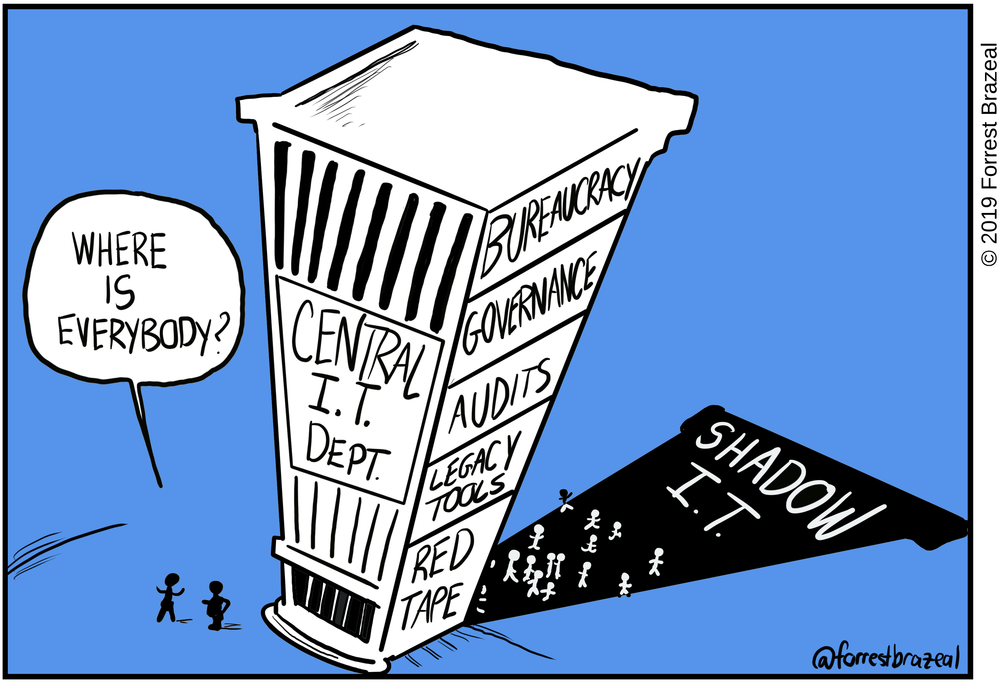
Shadow IT
Forrest Brazeal - https://faasandfurious.com/99
Notes:
We've all heard the term 'Shadow IT'. It's unmanaged IT--unmanaged technology. And Shadow IT represents the worst kind of attack surface—the kind you don’t know about.
used to be Desktop an employee brought in to play music for the office. Plug it in - an ethernet wall jack: they get music, you get an unmanaged device on the network.
now can be a dept w/credit card starting an Azure sub, putting company data in a SQL DB. Or an existing Azu sub connected to your on prem, with an engineer who creates and hands off a function app for a dev to play with this cool new tech.
New technology brings new security concerns—new attack surface. Even if it is just in the form of new avenues for the same old techniques. So for a biz/non-profit when New Tech, what are the options?
Prevent (new, not yet used, any use = shadow IT so prohibit)
Implement now, figure it as you go, pay the piper later. Security comes after. After five departments deployed serverless in 3 different cloud providers, someone (hopefully someone internal to the org and not Brian Krebs). Then there is the scramble to develop a standard and everyone undergoes painful process of aligning to the standard along with all the rework that entails (and that is frankly a best case scenario, because the alternative is the risk of missing something that could lead to a breach).
Secure by Design - security (whether dedicated personnel or simply considerations) is part of the adoption of a technology, and secure standards, design patterns, and templates are created
[]

Slide 13




Policy
People
Preventative Controls
Detective Controls
Notes:
Hear me on this: as a business or nonprofit, you need to get ahead of new technologies to reap the benefits and avoid the risks—and people are the key. you need either technology-minded security folks, or security-minded technology folks. A group who evaluate the new tech for your company, with the passion, ability, and time to think ahead. This could be a practice area, center of excellence, guild, tiger team—whatever the term you want to wrap around it.
They need to create governance [X] around these technologies: what is appropriate use, what is misuse, define what appropriate use looks like
and how inappropriate use will be [X] prevented or [X] detected. Policy and Controls to address each of those attacker opportunities, and reduce or mitigate your attack surface. Not blocker, AND to help with adoption! To provide guidance, templates, example deployments to let serverless have the greatest impact and benefit possible. Serverless is awesome. Make sure it serves you, not your adversaries.

Slide 14

Thank You
https://github.com/epopisces/talk_attack-surface-as-a-service

